Slide 1
Goals and Attributes of Success and Guiding Principles
Nona Hall, BSN, MA
DoD/VA Interagency Program Office
ONC Liaison

Slide 2
Why?
“To help people live the healthiest lives possible.”
The start of a Learning Healthcare System is accurate, computable, data.
4

Slide 3
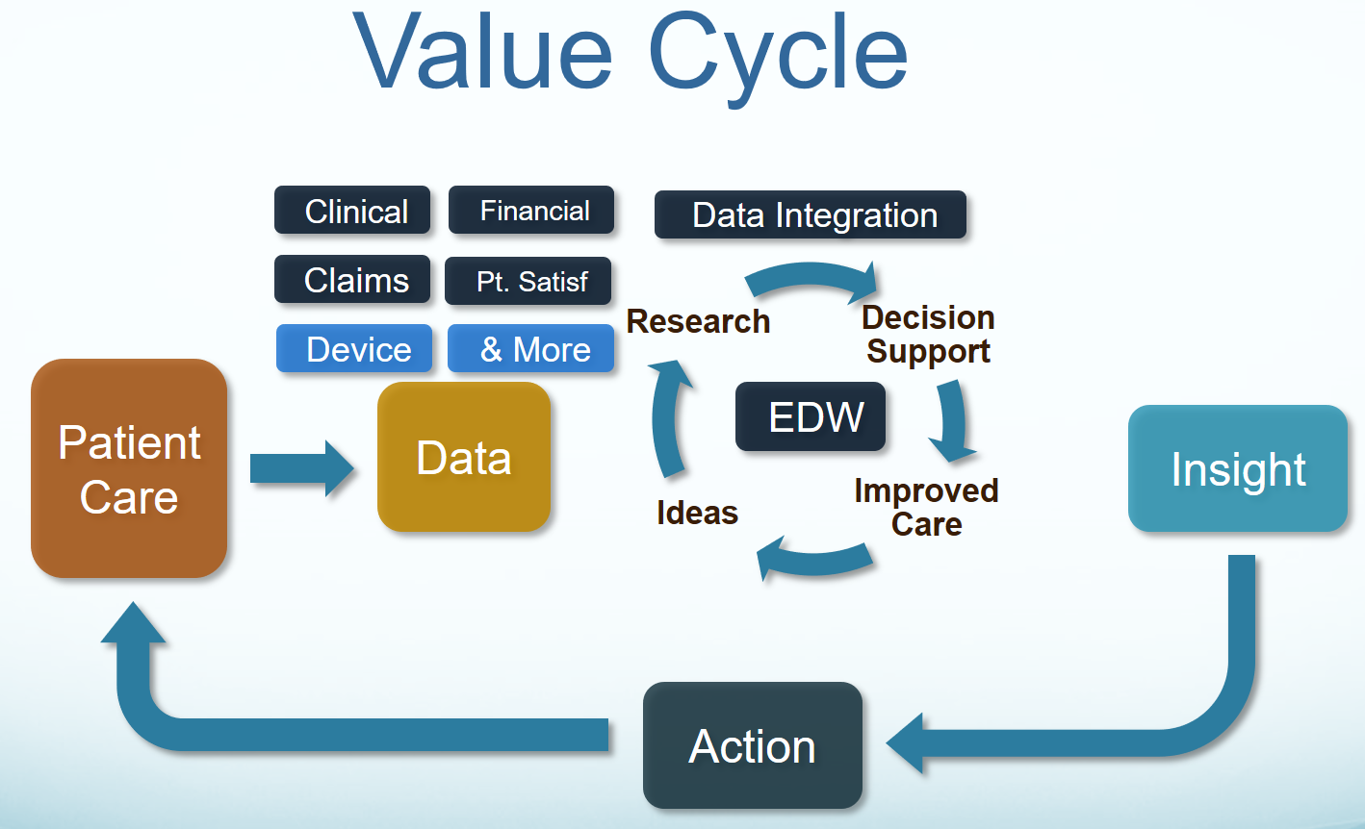
Key Benefits
Our goal is “To help people live the healthiest lives possible;” where, the foundation of a Learning Healthcare System is accurate, computable, data starting with the integration of CIMI, FHIM, SOLOR, CQF and other Information Models into a widely used HL7/ISO standard ^{[Stan Huff]}.

Slide 4
Agenda / References
Reference / Resources
Problem Statement / Current State
Context: Models & Tooling Assets
Integration Theme
Objectives / Attributes of Success
Guiding Principles…..a Starting Point
Approach / Who’s Engaged?
Where We’ve Been?
The Next Two Days
What Follows?

Slide 5
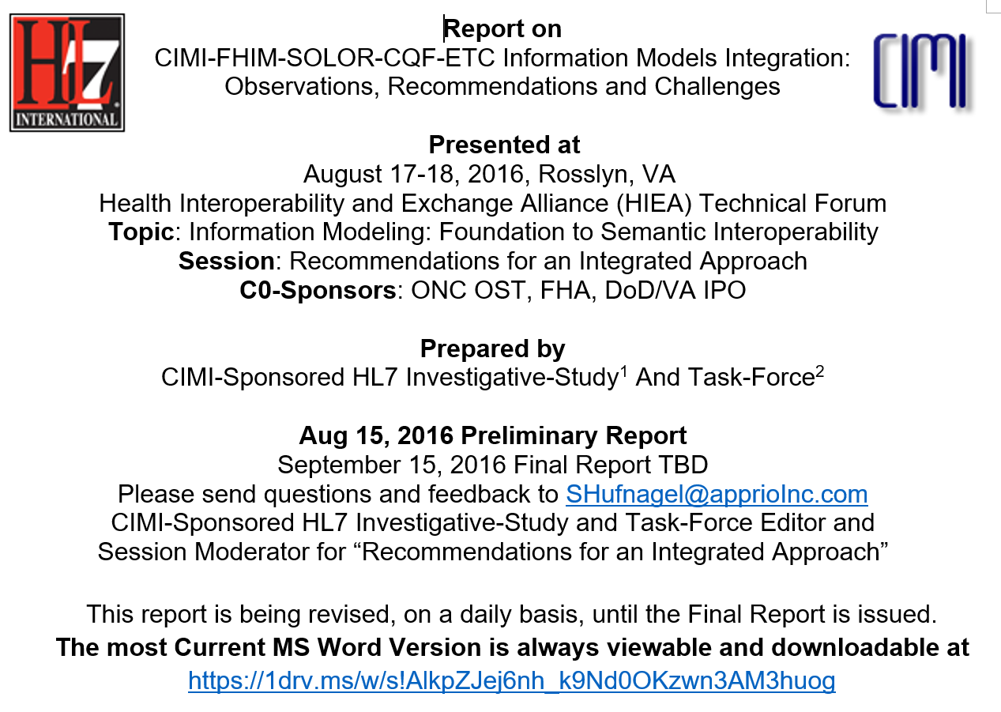

Slide 6
Problem Statement
The problem is that today’s systems do not capture the same information in the same way, and consequently, cannot easily share information or merge information from different sources to create a harmonized operational picture of a patient across multiple care locations and contexts.
Notes:
Common??? The word is not meant to stop innovation

Slide 7

Advancing Healthcare Interoperability
www.opengroup.org/bookstore/catalog/w16a.htm
Skyscraper Analogy
As-Is
‘To-Be’
Not Harmonized
Not Harmonized
Harmonized
Without use of Information Models to jumpstart an effort, is as if to pursue the ultimate skyscraper starting on the 3rd floor. Without the benefit of a sound foundation the ability to share across systems will meet barriers and impose unnecessary variation. It will cost time and money
Here each has its foundation (information model) however they are siloed. Models here have not been harmonized at the basic level. They do not share meanings. They cannot communicate together.
Shared Meaning
The bottom floors of the skyscrapers are bound together by shared meaning. Models are harmonized. They share meanings at the foundation level. They can interoperate. The whole is greater than the sum of the parts.
*Drawn from The Open Group Healthcare Forum (HCF) article:
Advancing Healthcare Interoperability www.opengroup.org/bookstore/catalog/w16a.htm
Notes:
Analogy of the Challenge: Today’s efforts occur as if we’re always trying to build the ultimate skyscraper, starting on the 3rd Floor
Inconsistencies exist/become extended producing transformational (mapping) efforts = models, models everywhere

Slide 8
Current State
Lack of data consistency across systems has led to exchange standards that are purposefully left extremely flexible, leaving many options to model the same thing differently
Multiple models and approaches
“models, models everywhere”
Inconsistent models
Mapping/transformation issues
Implementation Variability
Notes:
Implementation variability complicates governance
Information Modeling & Tooling Assets + Integration (Shared) Strategy = Supplies Missing Foundation

Slide 9
Context: Models/Tooling Assets
SOLOR
Creates Lightweight Expression of Granular Objects using SNOMED, LOINC, RxNorm within Detailed Clinical Models. It is an integration of SNOMED, LOINC, and RxNorm that can be treated as a single, coherent terminology systems with description-logic semantics.
FHIM
is Federal Healthcare Information Model, which is a high-level logical healthcare model, which covers approximately 36 clinical domains and has been vetted by Federal Agency SMEs and clinicians.
CIMI
is Clinical Information Model Initiative which defines Terms-of-Reference AKA Principles and modeling style guidelines; where, a CIMI Model is a clear, complete, concise, correct and consistent logical semantic-and-syntactic description of a healthcare concept, which can be instantiated as a computable implementation object that is interoperable among systems.
FHIR
defines a set of "Resources" that represent granular clinical concepts. The resources can be managed in isolation, or aggregated into complex documents.
CQF
is Clinical Quality Framework to support Continuous Quality Improvement (CQI) with a Quality Improvement and Clinical Knowledge or QUICK data model, Clinical Quality Language (CQL) supporting clinical decision support (CDS) and clinical quality measures (CQM).
Others
Standards Coordination initiatives (DAF, SDC, etc)
Interoperability Proving Ground
MDHT
MDHT is a suite of tools that is used to support the design and implementation of healthcare standards
MDMI
MDMI is an open standard (OMG) that specifies a UML Model for interoperability
For the FHIM, MDMI provides semantic alignment between the different Interoperability specifications and different logical models
Notes:
SOLOR Terminology Model ….what it really means
FHIM = Use
CIMI = Offers via DCMs the specifics supportive for detailed applications
FHIM = Provides the conceptual / logical view of all the data in your enterprise even though you would never build it that way; it none the less is there to consistently offer all the spokes that need to come together anchoring them all via the hub. It gives you common language all can talk Grants that understanding to the semantics Treat FHIM as in support of what’s needed for a shopping list whereas you are collecting the necessary components. With
CIMI is the taxonomy among the terms
C-CDA is about the data sharing
FHIR is about transport model; standardizes the FW built for moving resource / enables the exchange of info within the system and ideally it will conform to the FHIM/CIMI;
Domain model: An explicit description of a domain in terms of concepts, properties and attributes, and constraints, defining a common vocabulary. Domain model characteristics: Closed (but extensible), useful for defining objects, properties, and relationships, often (not exclusively) expressed in UML. Sometimes called “conceptual” or “domain analysis” model.
Example: Pressure Ulcer Prevention Domain Analysis Model (http://wiki.hl7.org/images/b/be/PressureUlcerPreventionDomainAnalysisModel_May2011.pdf)
Information model: A representation of what data is associated with a domain and how that data is structured. Similar to a domain model, but with a focus on representing the information associated with the domain, rather than the domain objects themselves. Information models commonly are developed at the logical level, that is, they are specific about what data is captured, but do not specify database structures. Should include metadata (information about the information collected). Information model characteristics: Closed, includes metadata, useful for constructing artifacts using Model-Driven Architecture.
Example: FHIM
Ontology: A formal naming and definition of the types, properties, and interrelationships of the concepts that really or fundamentally exist for a particular domain. An ontology can be developed for specific domain model or it can also be used across multiple domain models. Ontology characteristics: Open, useful for automated reasoning, often (but not exclusively) expressed in OWL.
Example: SNOMED-CT
Taxonomy: A taxonomy is similar to an ontology, but taxonomy is usually only a hierarchy of concepts, while an ontology supports complex relationships between concepts.
Example: CMS Healthcare Provider Taxonomy Code Set (https://www.cms.gov/medicare/provider-enrollment-and-certification/medicareprovidersupenroll/taxonomy.html)
Data Element: A unit of data for which the definition, identification, representation, and permissible values are specified. May not, in itself, provide complete context. May also be posed as a question-answer pair.
Example: US National Library of Medicine Data Element Catalog (https://www.nlm.nih.gov/healthit/dec/)
Exchange Package: A set of information that is transferred between systems. The logical contents of exchange packages will be defined in terms of individual or groups of data elements. The logical content is independent of the wire format (syntax), but often the definition of an exchange package includes a specific syntax (how the information is serialized for transport).
Example: HL7 V2.5 ADT message, Continuity of Care Document
Transformation (often just called mapping) is the process of mapping between data fields and the translation of terminology needed when the source information model, the local contents of the exchange package, or the target information models are not identical.
FHIM / CIMI are informaton models (conceptual / logical) they are not physical / implementation models
HL7 2.3, 2.8,3.0 separate chunks of data to get transported…..transport mechanism – more about data sharing

Slide 10

Each Model/Asset Plays a Role
CIMI
FHIM
SOLOR
Notes:
Each asset offers a unique contribution; SOLOR offers the terminology base; FHIM, the branches of the tree; CIMI, the leaves on the tree; FHIR accelerates implementation; tooling makes models meaningful to implementers
SOLOR – meaning
FHIM – use
CIMI – extended detauked use for a specific application area
Concrete Example In SOLOR / RxNorm = description of dosage of penicillin and what it means; With the use of the FHIM it will tell you if its part of substance administration and/or adverse event. RxNorm doesn’t do that
CIMI offers a DCM the providers can use in the detailed execution of a particular domain

Slide 11
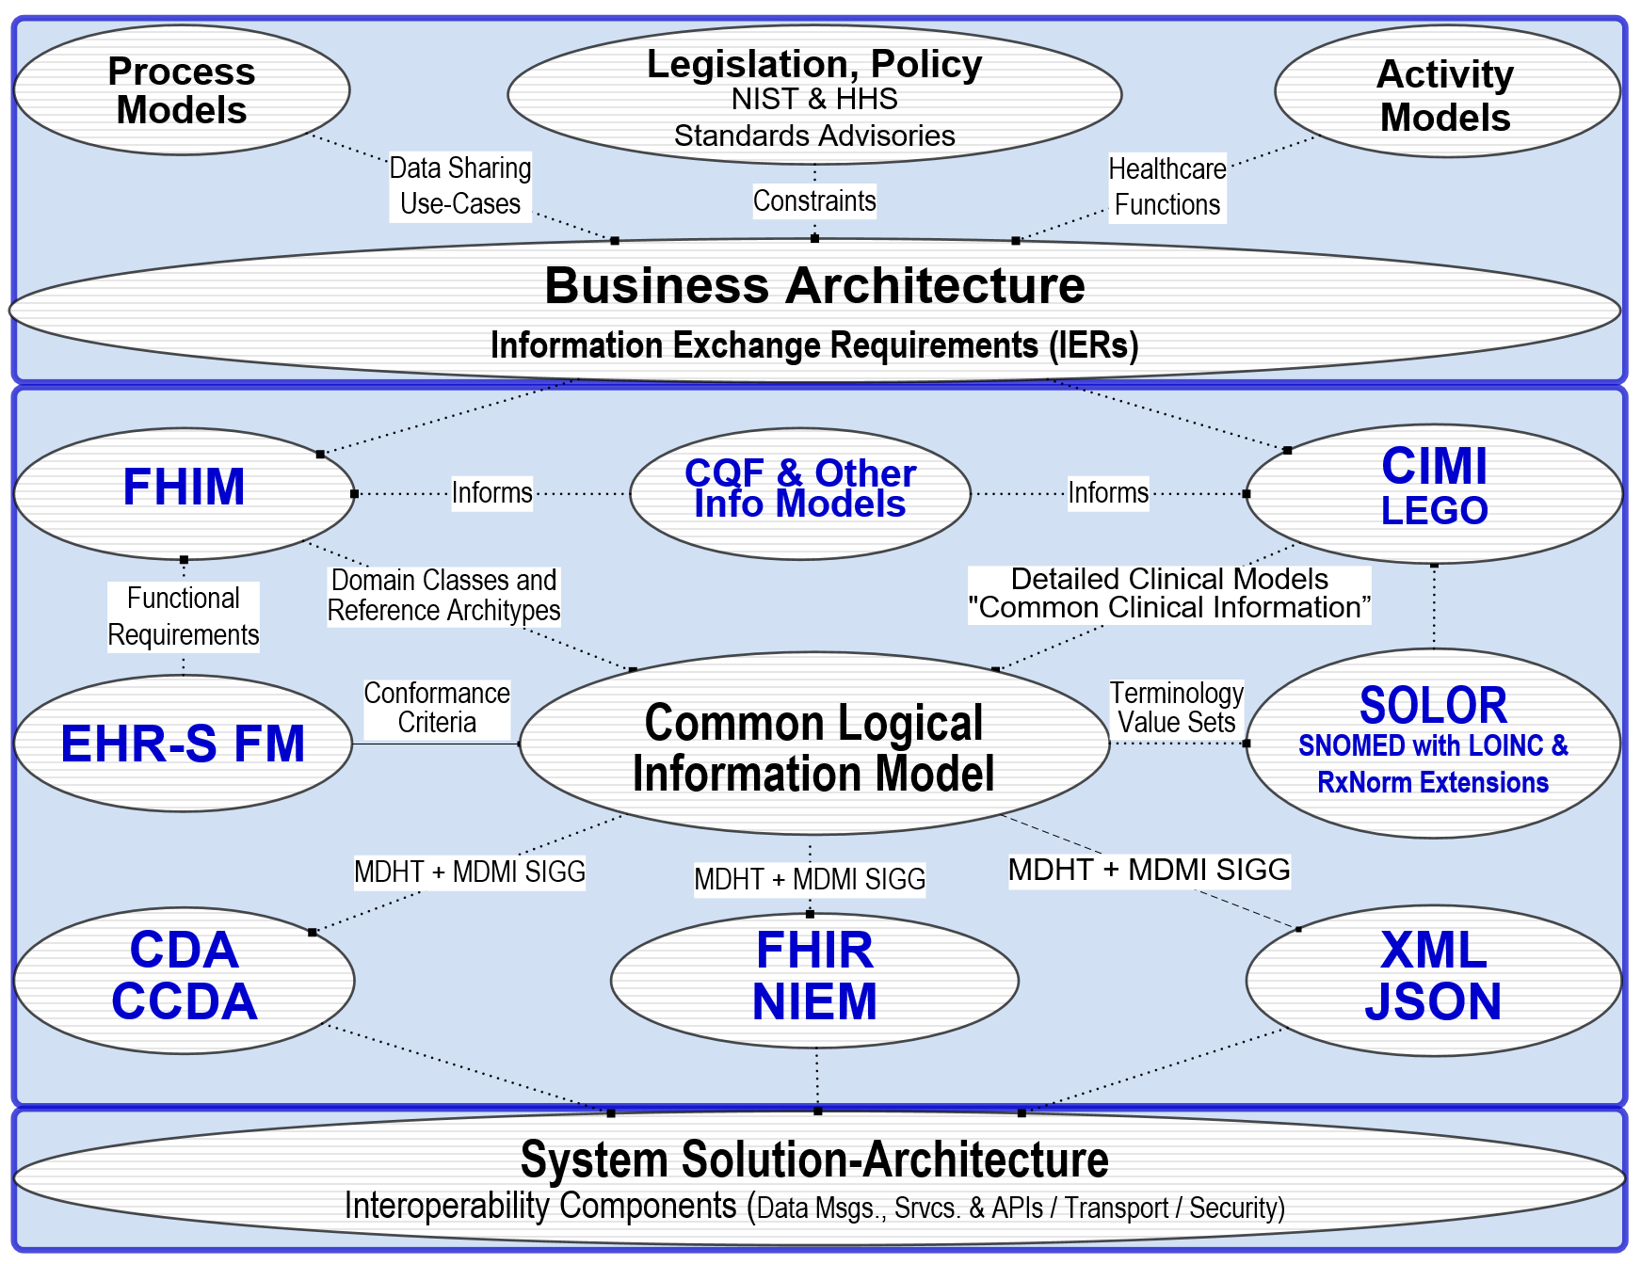
Proposed Solution: Integration Theme
The proposed solution involves the definition of clinical knowledge in the form of formally modeled information artifacts that could be used in compose-able health records, care plans and other shared clinical data. Each information artefact will be defined with an unambiguous and computable meaning, employ a specific, shared vocabulary, and have a specific information structure.
High-Level View of FHIM-CIMI-SOLOR-CQF Integration enables Consistent “Foundational Health Information” and “Common Clinical Information” to support Computable Semantic-Interoperability in Implementations
Notes:
No one asset can address the need
Each asset offers a unique contribution; SOLOR offers the terminology base; FHIM, the branches of the tree; CIMI, the leaves on the tree; FHIR accelerates implementation; tooling makes models meaningful to implementers
Circumstances are conducive: licensing flexibility; current state of each asset individually warrants a new (shared) vision
Integration brings together/streamlines efforts/creates efficiencies

Slide 12
Objectives
Integrate Models as the Enabling Foundation
Pursue the Integration of Models
Integrate Tooling to Extend the Utility of these Assets
Demonstrate the Viability of Integration Via Pilots
Notes:
First, in order to establish the needed foundation, information models need to be intregrated
Second, the facg that there is now a proliferation of models, produces the necessity to bring these together; to unify establishing shared meaning
Third, in and of themselves information models don’t answer the mail; to make them meaningful to implementers and to minimize the implementation variability tooling needs to be integrated – to extend the utility of these assets
Finally and to get beyond Modelilzing & Philozohuizing, demonstrating the viability of the models / their integration is through pilots

Slide 13
Attributes of Success
Increased awareness related to Information Modeling/Tooling & Integration efforts—the necessity
Distinction
Utility
Advocacy to routinely ‘Jump Start’ with (formal) information Modeling / Tooling Assets into projects / standards development efforts
Advocacy to support follow-on efforts
Sustain Core SME Framework to refine integration recommendations
Sustain predictable stakeholder contact
Apply insights / recommendations from Info Modeling Tech Forum into final report
Conduct follow up Modeling Meeting with FHIR colleagues, 15 Sep 2016
Submit final report during Sep 2016 HL7 CIMI Workgroup
Build out near term, mid term & long term efforts via work breakdown
Supportive of Integration
RePurposing and Resourcing considerations to meet near term, mid term and long term needs
Continue efforts to enhance usability; expand SME base, build User Community participation & promote shifting in commitments & to gauge progress for the work ahead
Notes:
The goal is to define common healthcare information elements that can serve as the basis for frictionless information sharing and creation of a single, aggregated, portable, and standard patient health record.

Slide 14
Guiding Principles…..a Starting Point
CIMI Principles: Appendix E *
So far, the modeling SMEs recommend adding the following foundational principles:
A clean separation of clinical model semantics
using SNOMED, LOINC and RxNORM
*CIMI-FHIM-SOLOR-CQF and Other Information Model Integration: Observations, Recommendations and Challenges Preliminary Report 17 Aug 2016.
Current Report at: https://1drv.ms/w/s!AlkpZJej6nh_k9Nd0OKzwn3AM3huog
Notes:
Guiding Principles
Benefit: Organizes the manner resources interact to help minimize inconsistencies
CIMI approved Detailed Clinical Models (DCMs) must be in a CIMI approved syntax: [style]

Slide 15
Approach: Integration/Convergence
Key to Success: Drawing upon our strong SME base!
Where We’ve Been?
FHIM Value / Evaluation, report provided Jun 2016 FHA Managing Board
FHIM-CIMI Investigative Study presented Jan 2016 HL7 Wkgp Meeting
Core SME Framework established
FHA, DoD/VA IPO and ONC/OST co sponsorship obtained
May 2016 HL7 Wkgp Meeting leveraged to develop outline supportive of two-day event
SME Prep Sessions conducted to discuss/negotiate going forward efforts maturing content/work breakdown, May-present
Pre-Education Seminars
The Next Two Days
Education, Collaboration & Commitments between Stakeholders
Detailed Agenda Walk Through
Recommendations & Next Steps
Notes:
Subject Matter Experts from across the Federal, US, and International Community
With decades of experience, these ‘founders in this field’ view current circumstances ripe for integration
Champions from HL7 - CIMI / HSPC, FHA – FHIM, DoD, VA, IPO, ONC/OST via CQF, Open Group, FHIR, ISO Community
Accent via Biographies
Clinicians
Analysts
Computer Scientists, Engineers and Architects
Implementers
These SMEs are your best chance of success

Slide 16
Current Agenda Day 1
Wednesday, August 17, 2016 8:30 am to 4:45 pm
8:30 – 8:45 | Arrival/Check-in
8:45 – 8:55 | Welcome and Agenda Review | Ms. Yvonne Cole (DoD/VA IPO)
8:55 – 9:00 | Logistics Review | Ms. Lori Hyzdu (DoD/VA IPO Support)
9:00 – 9:30 | HIEA Overview and JET Updates | Ms. Yvonne Cole (DoD/VA IPO) Mr. Chris Hills (DoD/VA IPO) Mr. Russ Ott (DoD/VA IPO Support)
9:30 – 9:45 | Setting the Stage & Perspectives from our Sponsors | Dr. Lauren Thompson (DoD/VA IPO) Mr. Steve Posnack (ONC/OST) Ms. Gail Kalbfeisch (FHA)
9:45 – 10:00 | BREAK
10:00 – 11:00 | Goals and Attributes of Success and Guiding Principles | Ms. Nona Hall (DoD/VA IPO)
11:00 – 11:30 | Current State of DoD and VA Information Modeling | DoD: Mr. Bart Bartholomew (DHA), Ms. Nancy Orvis (DHA) VA: Mr. Bob Bishop (VHA), Mr. Robert Crawford (VHA)
11:30 – 12:30 | LUNCH
12:30 - 3:00 | Logical Information Models: Current State/Analysis of Similarities and Differences across Clinical Data Models
 | SOLOR CIMI FHIM CQF | Mr. Keith Campbell, MD (VHA) Mr. Stan Huff, MD (InterMountain) Mr. Steve Wagner (FHA) Ms. Julia Skapik, MD (ONC/OST)
3:00 - 3:15 | BREAK
3:15 - 4:15 | Recommendations for an Integrated Approach | Mr. Steve Hufnagel (FHA Support)/Task Force Panel Representatives
4:15 – 4:45 | Closing Remarks/Recap Parking Lot Interests/Questions for Day 2 Action Item Review | Ms. Nona Hall (DoD/VA IPO) Ms. Veronica Kwok (DoD/VA IPO Support)
4:45 - 6:30 | Networking Hour (Optional) | Continental Pool Bar and Lounge

Slide 17
Current Agenda Day 2
Thursday, August 18, 2016 8:45 am to 4:30 pm
8:45 – 9:00 | Arrival/Check-in
9:00 – 9:10 | Recap & Agenda Overview | Ms. Yvonne Cole (DoD/VA IPO)
9:10 – 10:30 | Interests & Recommendations for an Integrated Approach, Cont’d Parking Lot Prioritization/Disposition of Questions / Interests from Day 1 Summary of Integration Plan Recommendations from day 1: Discussion of challenges & issues to be addressed | Ms. Nona Hall (DoD/VA IPO), TBD Mr. Steve Hufnagel (FHA Support)/Task Force Panel Representatives
10:30 – 10:45 | BREAK
10:45– 12:15 | Lessons from Implementers Discussion of Implementer experiences with information models. Description of experience with information models | Mr. Stan Huff, MD (InterMountain) Ms. Julia Skapik, MD (ONC/OST), Mr. Floyd Eisenberg, MD Mr. Marc Overhage (Cerner) Mr. Matt Braunschweigg (DaVita)
12:15 – 1:15 | LUNCH | 4th Floor Cafeteria
1:15 – 2:15 | Tooling & Implementer Support Unique contributions; gaps addressed; capability/functionality that supports information modeling MDHT MDMI VSAC SOLOR related | Mr. Dave Carlson (FHA Support) Mr. Sean Muir (VA Support) Mr. Steve Emrick (NLM) Mr. Keith Campbell, MD (VHA)
2:15 – 2:30 | BREAK
2:30 – 4:00 | Recommendations and Next Steps Summary of Recommendations from the 2 days Discussion of Pilot Project Options to support Organizational Adoption | Ms. Nona Hall (DoD/VA IPO) Mr. Keith Campbell, MD (VHA) Mr. Stan Huff, MD (InterMountain) Mr. Steve Wagner (FHA Support) Ms. Julia Skapik, MD (ONC/OST) Co Sponsors/Leadership Dr. Lauren Thompson (DoD/VA IPO) Mr. Steve Posnack (ONC/OST) Ms. Gail Kalbfleisch (FHA)
4:00 – 4:30 | Recap/Closing/Acknowledgements Upcoming Related Activities Action Item Review | Ms. Nona Hall (DoD/VA IPO)/Core SMEs, as needed Ms. Veronica Kwok (DoD/VA IPO Support)
Notes:
Supportive discussions:
CIMI/FHIM Convergence: support is necessary moving forward
Additionally: those as logical model mean we need to make the connection to implementation (FHIR Profiles..)
Emphasize value in bringing in SOLOR using SNOMED to accent on our goals
Practical Pilots: we can work around sharing in the development of tools and specifically how we add content; pilots provide a way to add in content via the pilot experience
Endorsements sought via chunks:
-Models must be foundational
-Proceed with Integrating Models
-Integrate Models with Tools
-Leverage all of those to support true interoperability and generate implementations via pilots

Slide 18
Approach: Integration/Convergence, Cont’d
What Follows?
Conclude Preliminary Integration Report
15 Aug – Preliminary Report Released
19 Aug – 15 Sep – SME Sessions to drive report refinement
15 Sep – Conduct follow on Modeling Meeting with FHIR colleagues
Prior HL7 Wkgp Meeting: Pre coordinate with co sponsor / FHA Managing Board)
Sep 2016 HL7 Wkgp Meeting – Final Report, Submit to HL7 CIMI Workgroup
Pilot Opportunities:
DoD/VA JET: FHIR Proving Ground / MDHT-MDMI Introduction
Follow On CQF Shared Modeling activities
Explore other Pilot possibilities, e.g, JIF Proposal
Health Data Sharing Business Line Workgroups—follow on activities
Others?
Notes:
So far, the modeling SMEs recommend adding the following foundational principles: 1) A clean separation of clinical model semantics 2) using SNOMED, LOINC and RxNORM. See explanation of “A clean separation of model semantics” statement in Section 3 Recommended Additional Principle footnote and discussion in APPENDIX E Section 11.6 Discussion on Recommended New Principle

Slide 19
Approach that is Key to Success: Collaboration that Grows with Strong SME Base
CIMI Co-Chairs:
Linda Bird BIT, IHTSDO, lbi@ihtsdo.org
Galen Mulrooney, FHA and VA, galen.mulrooney@jpsys.com
Harold Solbrig, Mayo Clinic, solbrig.harold@mayo.edu
Stanley Huff, Intermountain Healthcare, stan.huff@imail.org
Members of the following SDOs have participated
IHTSDO, POC: Linda Bird BIT
HL7 Work Groups (PC, CDS, CIC, EHR, SOA, Vocab)
The Open Group Healthcare Forum, Jason Lee POC
ISO/CEN, POCs: Gerard Freriks, William Goossen, Gary Dickinson
Federal Agency staff and contractors have participated
Department of Defense
Veterans Administration
Interagency Program Office
ONC and its Federal Health Architecture
Members of the following Healthcare Organizations have participated
Intermountain Healthcare
PenRad, Inc.
Results4Care
Faculty, Staff and students from the Following Universities have participated in CIMI:
The University of Utah
Notes:
Subject Matter Experts from across the Federal, US, and International Community
With decades of experience, these ‘founders in this field’ view current circumstances ripe for integration
Champions from HL7 - CIMI / HSPC, FHA – FHIM, DoD, VA, IPO, ONC/OST via CQF, Open Group, FHIR, ISO Community
Accent via Biographies
Clinicians
Analysts
Computer Scientists, Engineers and Architects
Implementers
These SMEs are your best chance of success

